Slide 1
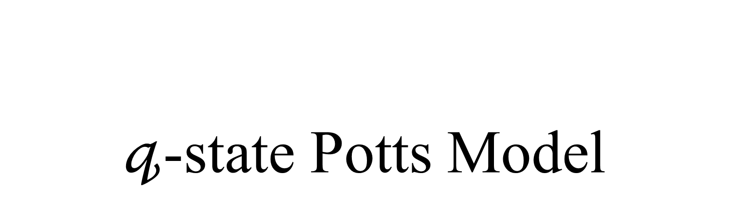
$𝓆$-state Potts Model
LEE SungBin

Slide 2
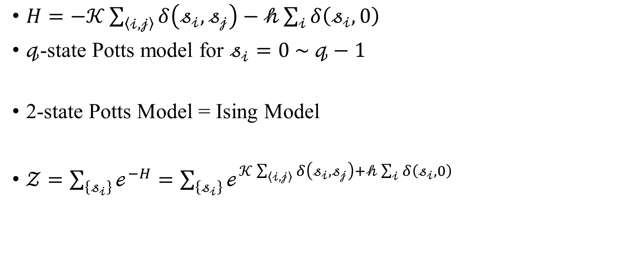
Introduction
$H=−𝒦\sum_{\left\langle 𝒾,𝒿\right\rangle }{δ\left(𝓈_{𝒾},𝓈_{𝒿}\right)}−𝒽\sum_{𝒾}{δ\left(𝓈_{𝒾},0\right)}$
$𝓆$-state Potts model for $𝓈_{𝒾}=0 \sim 𝓆−1$
2-state Potts Model = Ising Model
$𝒵=\sum_{\left\{𝓈_{𝒾}\right\}}{ℯ^{−H}}=\sum_{\left\{𝓈_{𝒾}\right\}}{ℯ^{𝒦\sum_{\left\langle 𝒾,𝒿\right\rangle }{δ\left(𝓈_{𝒾},𝓈_{𝒿}\right)}+𝒽\sum_{𝒾}{δ\left(𝓈_{𝒾},0\right)}}}$

Slide 3
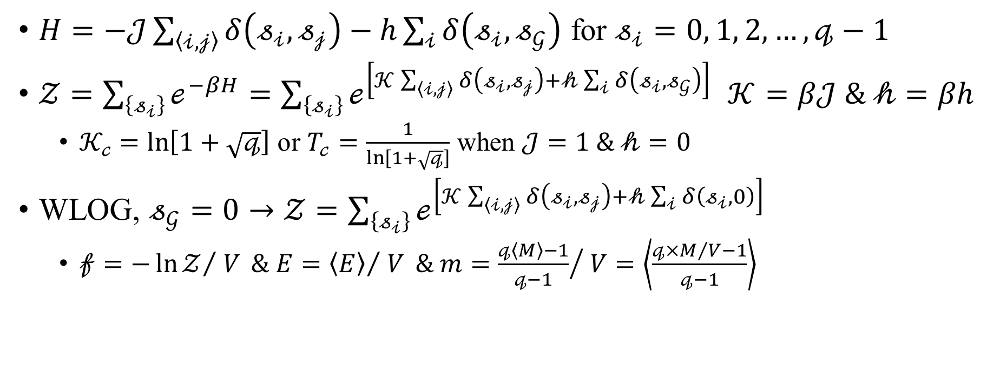
Hamiltonian – Alternative Form
$H=−𝒥\sum_{\left\langle 𝒾,𝒿\right\rangle }{δ\left(𝓈_{𝒾},𝓈_{𝒿}\right)}−h\sum_{𝒾}{δ\left(𝓈_{𝒾},𝓈_{𝒢}\right)}$ for $𝓈_{𝒾}=0, 1, 2,…,𝓆−1$
$𝒵=\sum_{\left\{𝓈_{𝒾}\right\}}{ℯ^{−βH}}=\sum_{\left\{𝓈_{𝒾}\right\}}{ℯ^{\left[𝒦\sum_{\left\langle 𝒾,𝒿\right\rangle }{δ\left(𝓈_{𝒾},𝓈_{𝒿}\right)+𝒽\sum_{𝒾}{δ\left(𝓈_{𝒾},𝓈_{𝒢}\right)}}\right]}}$ $𝒦=β𝒥 \& 𝒽=βh$
$𝒦_{𝒸}=\ln\left[1+\sqrt{𝓆}\right]$ or $T_{𝒸}=\frac{1}{\ln\left[1+\sqrt{𝓆}\right]}$ when $𝒥=1 \& 𝒽=0$
WLOG, $𝓈_{𝒢}=0→𝒵=\sum_{\left\{𝓈_{𝒾}\right\}}{ℯ^{\left[𝒦\sum_{\left\langle 𝒾,𝒿\right\rangle }{δ\left(𝓈_{𝒾},𝓈_{𝒿}\right)+𝒽\sum_{𝒾}{δ\left(𝓈_{𝒾},0\right)}}\right]}}$
$𝒻=−{\ln{𝒵}}/{ V} \& E={\left\langle E\right\rangle }/{ V} \& m={\frac{𝓆\left\langle M\right\rangle −1}{𝓆−1}}/{ V}=\left\langle \frac{𝓆×M/V−1}{𝓆−1}\right\rangle$

Slide 4
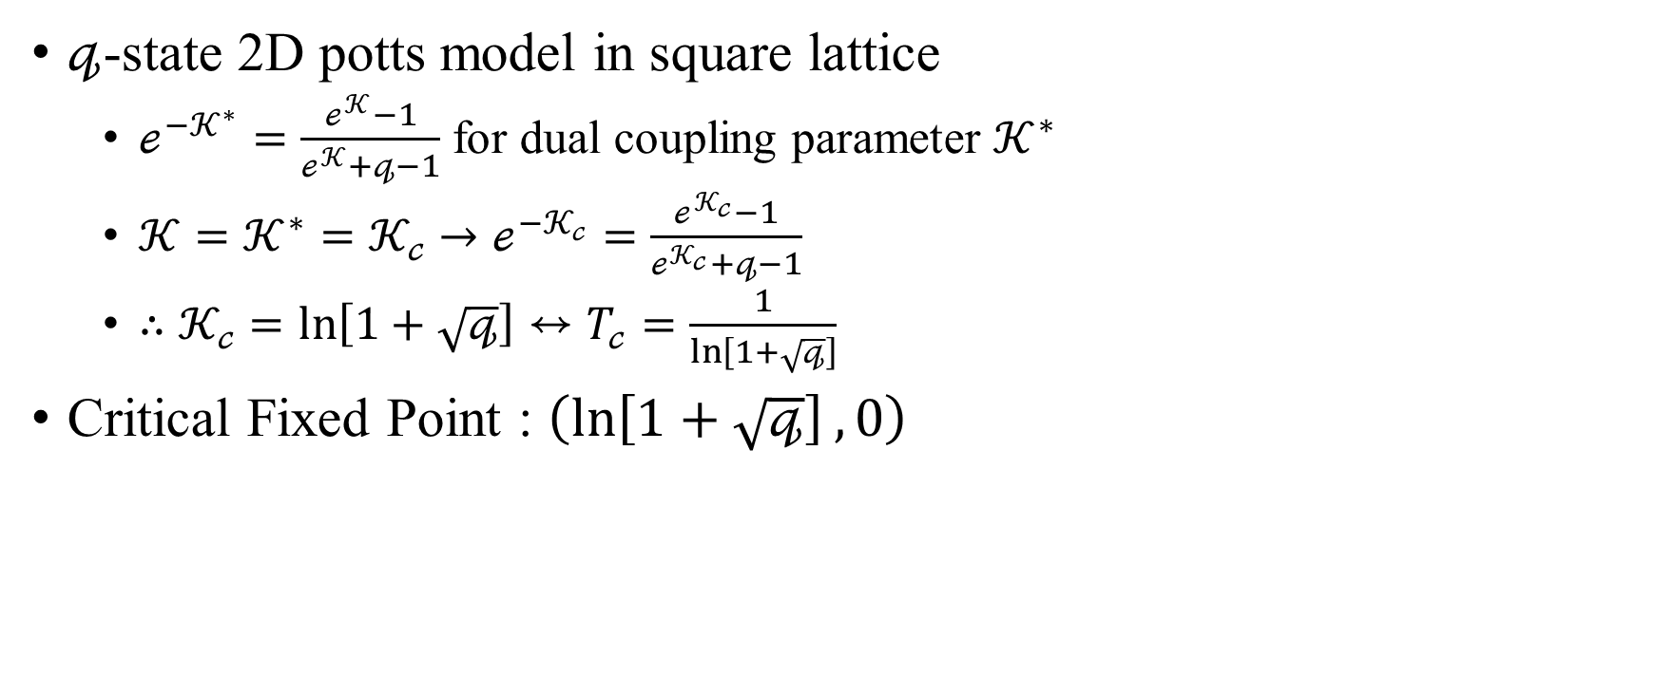
Critical Temperature
$𝓆$-state 2D potts model in square lattice
$ℯ^{−𝒦^{∗}}=\frac{ℯ^{𝒦}−1}{ℯ^{𝒦}+𝓆−1}$ for dual coupling parameter $𝒦^{∗}$
$𝒦=𝒦^{∗}=𝒦_{𝒸}→ℯ^{−𝒦_{𝒸}}=\frac{ℯ^{𝒦_{𝒸}}−1}{ℯ^{𝒦_{𝒸}}+𝓆−1}$
$∴𝒦_{𝒸}=\ln\left[1+\sqrt{𝓆}\right]↔T_{𝒸}=\frac{1}{\ln\left[1+\sqrt{𝓆}\right]}$
Critical Fixed Point : $\left(\ln\left[1+\sqrt{𝓆}\right], 0\right)$

Slide 5
Binder Cumulant

Slide 6
Order Parameter

Slide 7
Susceptibility

Slide 8
Specific Heat

Slide 9
Correlation Function

Slide 10
Correlation Length

Slide 11
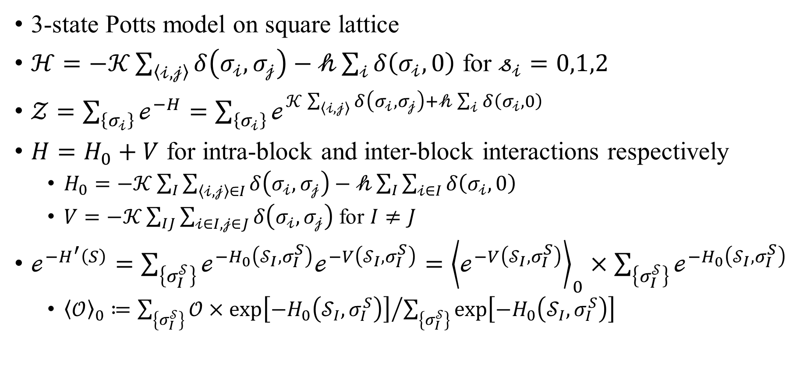
Block-Spin Transformation RG
3-state Potts model on square lattice
$ℋ=−𝒦\sum_{\left\langle 𝒾,𝒿\right\rangle }{δ\left(σ_{𝒾},σ_{𝒿}\right)}−𝒽\sum_{𝒾}{δ\left(σ_{𝒾},0\right)}$ for $𝓈_{𝒾}=0,1,2$
$𝒵=\sum_{\left\{σ_{𝒾}\right\}}{ℯ^{−H}}=\sum_{\left\{σ_{𝒾}\right\}}{ℯ^{𝒦\sum_{\left\langle 𝒾,𝒿\right\rangle }{δ\left(σ_{𝒾},σ_{𝒿}\right)}+𝒽\sum_{𝒾}{δ\left(σ_{𝒾},0\right)}}}$
$H=H_{0}+V$ for intra-block and inter-block interactions respectively
$H_{0}=−𝒦\sum_{I}{\sum_{\left\langle 𝒾,𝒿\right\rangle ∈I}{δ\left(σ_{𝒾},σ_{𝒿}\right)}}−𝒽\sum_{I}{\sum_{𝒾∈I}{δ\left(σ_{𝒾},0\right) }}$
$V=−𝒦\sum_{IJ}{\sum_{𝒾∈I,𝒿∈J}{δ\left(σ_{𝒾},σ_{𝒿}\right)}}$ for $I≠J$
$ℯ^{−H^{′}\left(S\right)}=\sum_{\left\{σ_{I}^{𝒮}\right\}}{ℯ^{−H_{0}\left(𝒮_{I},σ_{I}^{S}\right)}ℯ^{−V\left(𝒮_{I},σ_{I}^{S}\right)}}={\left\langle ℯ^{−V\left(𝒮_{I},σ_{I}^{S}\right)}\right\rangle }_{0}×\sum_{\left\{σ_{I}^{𝒮}\right\}}{ℯ^{−H_{0}\left(𝒮_{I},σ_{I}^{S}\right)}}$
${\left\langle 𝒪\right\rangle }_{0}≔{\sum_{\left\{σ_{I}^{𝒮}\right\}}{𝒪×\exp\left[−H_{0}\left(𝒮_{I},σ_{I}^{S}\right)\right]}}/{\sum_{\left\{σ_{I}^{𝒮}\right\}}{\exp\left[−H_{0}\left(𝒮_{I},σ_{I}^{S}\right)\right]}}$

Slide 12
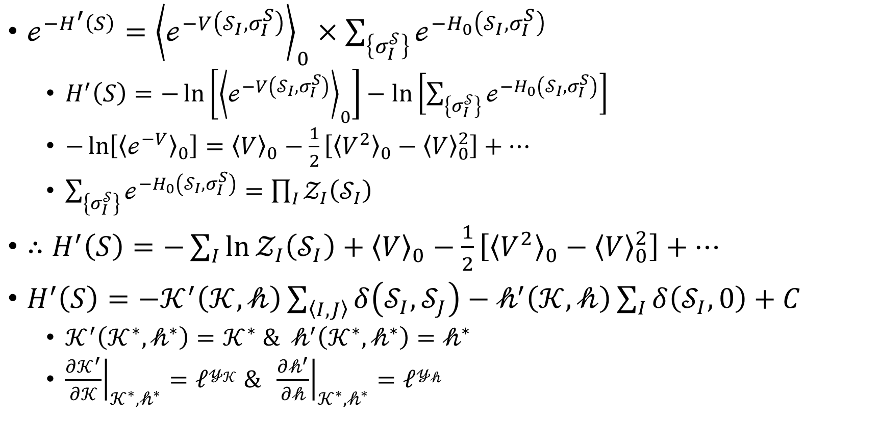
Block-Spin Transformation RG
$ℯ^{−H^{′}\left(S\right)}={\left\langle ℯ^{−V\left(𝒮_{I},σ_{I}^{S}\right)}\right\rangle }_{0}×\sum_{\left\{σ_{I}^{𝒮}\right\}}{ℯ^{−H_{0}\left(𝒮_{I},σ_{I}^{S}\right)}}$
$H^{′}\left(S\right)=−\ln\left[{\left\langle ℯ^{−V\left(𝒮_{I},σ_{I}^{S}\right)}\right\rangle }_{0}\right]−\ln\left[\sum_{\left\{σ_{I}^{𝒮}\right\}}{ℯ^{−H_{0}\left(𝒮_{I},σ_{I}^{S}\right)}}\right]$
$−\ln\left[{\left\langle ℯ^{−V}\right\rangle }_{0}\right]={\left\langle V\right\rangle }_{0}−\frac{1}{2}\left[{\left\langle V^{2}\right\rangle }_{0}−{\left\langle V\right\rangle }_{0}^{2}\right]+…$
$\sum_{\left\{σ_{I}^{𝒮}\right\}}{ℯ^{−H_{0}\left(𝒮_{I},σ_{I}^{S}\right)}}=\prod_{I}{𝒵_{I}\left(𝒮_{I}\right)}$
$∴H^{′}\left(S\right)=−\sum_{I}{\ln{𝒵_{I}\left(𝒮_{I}\right)}}+{\left\langle V\right\rangle }_{0}−\frac{1}{2}\left[{\left\langle V^{2}\right\rangle }_{0}−{\left\langle V\right\rangle }_{0}^{2}\right]+…$
$H^{′}\left(S\right)=−𝒦^{′}\left(𝒦,𝒽\right)\sum_{\left\langle I,J\right\rangle }{δ\left(𝒮_{I},𝒮_{J}\right)}−𝒽^{′}\left(𝒦,𝒽\right)\sum_{I}{δ\left(𝒮_{I},0\right)}+C$
$𝒦^{′}\left(𝒦^{∗},𝒽^{∗}\right)=𝒦^{∗} \& 𝒽^{′}\left(𝒦^{∗},𝒽^{∗}\right)=𝒽^{∗}$
${\left.\frac{∂𝒦^{′}}{∂𝒦}\right|}_{𝒦^{∗},𝒽^{∗}}=ℓ^{𝓎_{𝒦}} \& {\left.\frac{∂𝒽^{′}}{∂𝒽}\right|}_{𝒦^{∗},𝒽^{∗}}=ℓ^{𝓎_{𝒽}}$

Slide 13
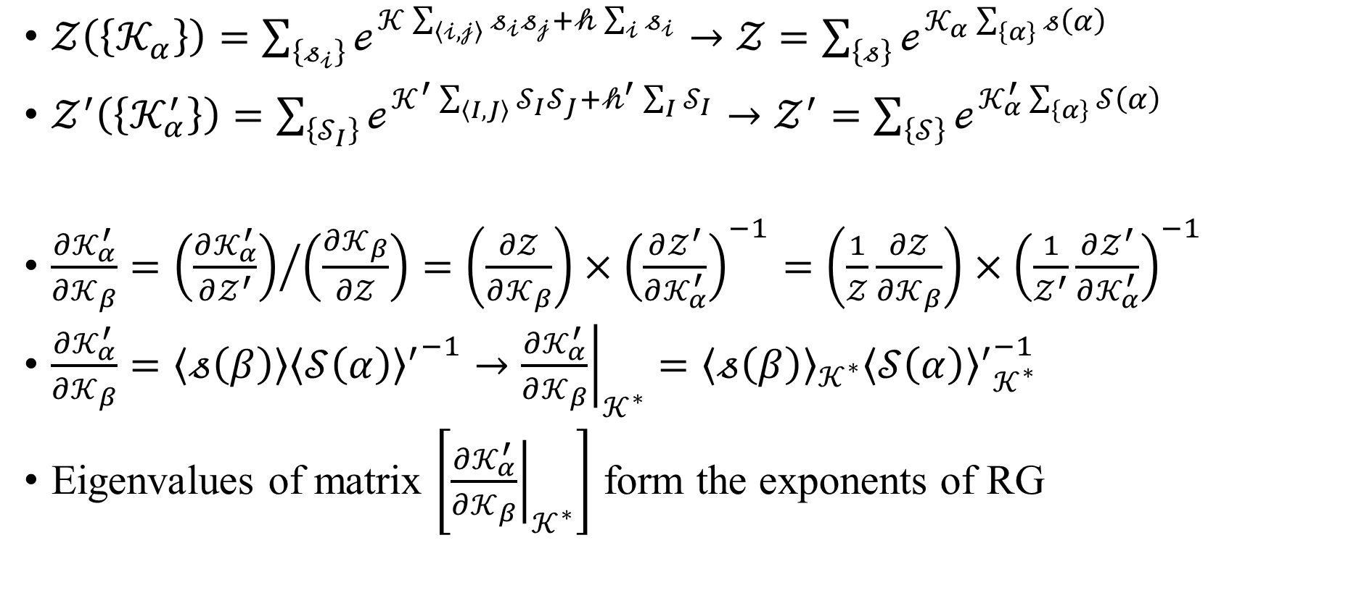
Monte Carlo RG
$𝒵\left(\left\{𝒦_{α}\right\}\right)=\sum_{\left\{𝓈_{𝒾}\right\}}{ℯ^{𝒦\sum_{\left\langle 𝒾,𝒿\right\rangle }{𝓈_{𝒾}𝓈_{𝒿}}+𝒽\sum_{𝒾}{𝓈_{𝒾}}}}→𝒵=\sum_{\left\{𝓈\right\}}{ℯ^{𝒦_{α}\sum_{\left\{α\right\}}{𝓈\left(α\right)}}}$
$𝒵^{′}\left(\left\{𝒦_{α}^{′}\right\}\right)=\sum_{\left\{𝒮_{I}\right\}}{ℯ^{𝒦^{′}\sum_{\left\langle I,J\right\rangle }{𝒮_{I}𝒮_{J}}+𝒽^{′}\sum_{I}{𝒮_{I}}}}→𝒵^{′}=\sum_{\left\{𝒮\right\}}{ℯ^{𝒦_{α}^{′}\sum_{\left\{α\right\}}{𝒮\left(α\right)}}}$
$\frac{∂𝒦_{α}^{′}}{∂𝒦_{β}}={\left(\frac{∂𝒦_{α}^{′}}{∂𝒵^{′}}\right)}/{\left(\frac{∂𝒦_{β}}{∂𝒵}\right)}=\left(\frac{∂𝒵}{∂𝒦_{β}}\right)×{\left(\frac{∂𝒵^{′}}{∂𝒦_{α}^{′}}\right)}^{−1}=\left(\frac{1}{𝒵}\frac{∂𝒵}{∂𝒦_{β}}\right)×{\left(\frac{1}{𝒵^{′}}\frac{∂𝒵^{′}}{∂𝒦_{α}^{′}}\right)}^{−1}$
$\frac{∂𝒦_{α}^{′}}{∂𝒦_{β}}=\left\langle 𝓈\left(β\right)\right\rangle {{\left\langle 𝒮\left(α\right)\right\rangle }^{′}}^{−1}→{\left.\frac{∂𝒦_{α}^{′}}{∂𝒦_{β}}\right|}_{𝒦^{∗}}={\left\langle 𝓈\left(β\right)\right\rangle }_{𝒦^{∗}}{{\left\langle 𝒮\left(α\right)\right\rangle }^{′}}_{𝒦^{∗}}^{−1}$
Eigenvalues of matrix $\left[{\left.\frac{∂𝒦_{α}^{′}}{∂𝒦_{β}}\right|}_{𝒦^{∗}}\right]$ form the exponents of RG

Slide 14
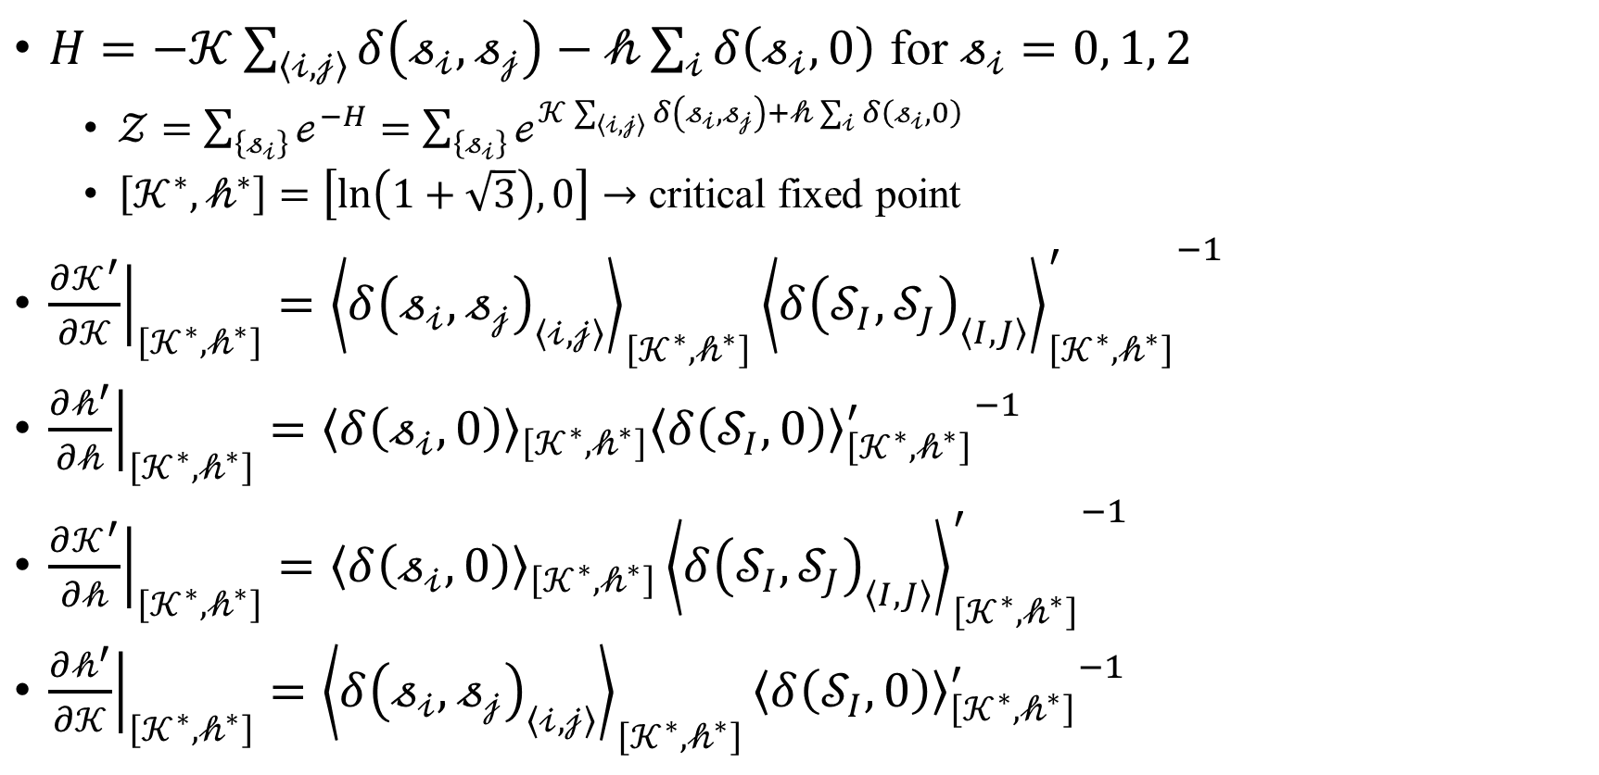
Monte Carlo RG
$H=−𝒦\sum_{\left\langle 𝒾,𝒿\right\rangle }{δ\left(𝓈_{𝒾},𝓈_{𝒿}\right)}−𝒽\sum_{𝒾}{δ\left(𝓈_{𝒾},0\right)}$ for $𝓈_{𝒾}=0, 1, 2$
$𝒵=\sum_{\left\{𝓈_{𝒾}\right\}}{ℯ^{−H}}=\sum_{\left\{𝓈_{𝒾}\right\}}{ℯ^{𝒦\sum_{\left\langle 𝒾,𝒿\right\rangle }{δ\left(𝓈_{𝒾},𝓈_{𝒿}\right)}+𝒽\sum_{𝒾}{δ\left(𝓈_{𝒾},0\right)}}}$
$\left[𝒦^{∗}, 𝒽^{∗}\right]=\left[\ln\left(1+\sqrt{3}\right), 0\right]→$ critical fixed point
${\left.\frac{∂𝒦^{′}}{∂𝒦}\right|}_{\left[𝒦^{∗},𝒽^{∗}\right]}={\left\langle δ{\left(𝓈_{𝒾},𝓈_{𝒿}\right)}_{\left\langle 𝒾,𝒿\right\rangle }\right\rangle }_{\left[𝒦^{∗},𝒽^{∗}\right]}{{\left\langle δ{\left(𝒮_{I},𝒮_{J}\right)}_{\left\langle I,J\right\rangle }\right\rangle }_{\left[𝒦^{∗},𝒽^{∗}\right]}^{′}}^{−1}$
${\left.\frac{∂𝒽^{′}}{∂𝒽}\right|}_{\left[𝒦^{∗},𝒽^{∗}\right]}={\left\langle δ\left(𝓈_{𝒾},0\right)\right\rangle }_{\left[𝒦^{∗},𝒽^{∗}\right]}{{\left\langle δ\left(𝒮_{I},0\right)\right\rangle }_{\left[𝒦^{∗},𝒽^{∗}\right]}^{′}}^{−1}$
${\left.\frac{∂𝒦^{′}}{∂𝒽}\right|}_{\left[𝒦^{∗},𝒽^{∗}\right]}={\left\langle δ\left(𝓈_{𝒾},0\right)\right\rangle }_{\left[𝒦^{∗},𝒽^{∗}\right]}{{\left\langle δ{\left(𝒮_{I},𝒮_{J}\right)}_{\left\langle I,J\right\rangle }\right\rangle }_{\left[𝒦^{∗},𝒽^{∗}\right]}^{′}}^{−1}$
${\left.\frac{∂𝒽^{′}}{∂𝒦}\right|}_{\left[𝒦^{∗},𝒽^{∗}\right]}={\left\langle δ{\left(𝓈_{𝒾},𝓈_{𝒿}\right)}_{\left\langle 𝒾,𝒿\right\rangle }\right\rangle }_{\left[𝒦^{∗},𝒽^{∗}\right]}{{\left\langle δ\left(𝒮_{I},0\right)\right\rangle }_{\left[𝒦^{∗},𝒽^{∗}\right]}^{′}}^{−1}$

Slide 15
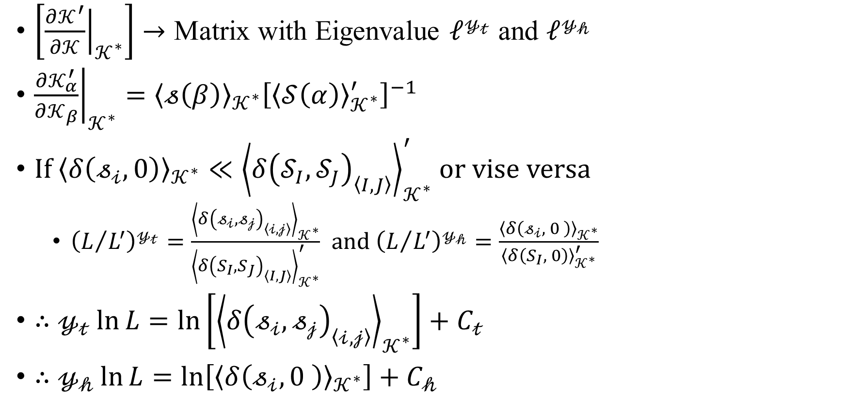
Monte Carlo RG
$\left[{\left.\frac{∂𝒦^{′}}{∂𝒦}\right|}_{𝒦^{∗}}\right]→$ Matrix with Eigenvalue $ℓ^{𝓎_{𝓉}}$ and $ℓ^{𝓎_{𝒽}}$
${\left.\frac{∂𝒦_{α}^{′}}{∂𝒦_{β}}\right|}_{𝒦^{∗}}={\left\langle 𝓈\left(β\right)\right\rangle }_{𝒦^{∗}}{\left[{\left\langle 𝒮\left(α\right)\right\rangle }_{𝒦^{∗}}^{′}\right]}^{−1}$
If ${\left\langle δ\left(𝓈_{𝒾},0\right)\right\rangle }_{𝒦^{∗}}≪{\left\langle δ{\left(𝒮_{I},𝒮_{J}\right)}_{\left\langle I,J\right\rangle }\right\rangle }_{𝒦^{∗}}^{′}$ or vise versa
${\left(L/{L^{′}}\right)}^{𝓎_{𝓉}}=\frac{{\left\langle δ{\left(𝓈_{𝒾},𝓈_{𝒿}\right)}_{\left\langle 𝒾,𝒿\right\rangle }\right\rangle }_{𝒦^{∗}}}{{\left\langle δ{\left(S_{I},S_{J}\right)}_{\left\langle I,J\right\rangle }\right\rangle }_{𝒦^{∗}}^{′}}$ and ${\left(L/{L^{′}}\right)}^{𝓎_{𝒽}}=\frac{{\left\langle δ\left(𝓈_{𝒾}, 0 \right)\right\rangle }_{𝒦^{∗}}}{{\left\langle δ\left(S_{I}, 0\right)\right\rangle }_{𝒦^{∗}}^{′}}$
$∴𝓎_{𝓉}\ln{L}=\ln\left[{\left\langle δ{\left(𝓈_{𝒾},𝓈_{𝒿}\right)}_{\left\langle 𝒾,𝒿\right\rangle }\right\rangle }_{𝒦^{∗}}\right]+C_{𝓉}$
$∴𝓎_{𝒽}\ln{L}=\ln\left[{\left\langle δ\left(𝓈_{𝒾}, 0 \right)\right\rangle }_{𝒦^{∗}}\right]+C_{𝒽}$

